Slide 1
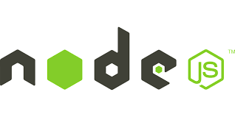
Banu Priya.S

Slide 2
Node js
Its open source in server side application
Before that we r using java script that means “browser only opening”
After that stand alone programming language
Server-Thread based
Node js - Event based (synchronous) …
Java Script used in client side but node js puts the
java script on Server side
client And server will happen in same language

Slide 3
Browser JS Stand alone program
Observe Events and File handling
Perform action create or remove
Change URL File from hard disk
Manipulate DOM connect DB
Change color perform query

Slide 4
Node js runs on window system can also runs on linux system
Simple words:
Node js server side java script
its command line tool
Advantages:
mainly reason Non-Blocking Input/output
Asynchronous and event Driven

Slide 5
Blocking Non-blocking
Request once complete multiple Request Its
after its next request single time Execution
Will be process (never wait for I/O)
Event Driven works on the Non-Blocking Model
Light weight and Efficient

Slide 6
Synchronous Asynchronous
Waits for each operation Never waits each
To complete, after that operation to
executes next operation complete, executes
all at one time
results handled
step by step execution callbacks used
to handled results

Slide 7

V8 engine :
it written c++ programming language
Its open source
That means machine understanding program
i.e program executed by V8
example(google chrome browser)

Slide 8
Node is not
web framework
Multithread
Why node js:
Fast
Handle tons of concurrent request
Suppose we written in js (same code server side and client side)

Slide 9


Where to use node js
I/O operations
chat Messaging
Real Time Applications
High concurrency Applications
Where you cannot use node js
Heavy computation
Large and complicated web Applications

Slide 10
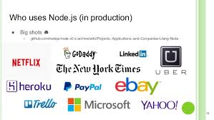
Who uses Node.js
Non-blocking concept

